Slide 1

Data Mining and Business Analytics MANB 1153 Semester II 2016/2017
Introduction

Slide 2
Agenda
The Instructors
Learning Outcomes
Course Outline

Slide 3
The Instructor
Dr Siti Sophiayati Yuhaniz
PhD (Univ. of Surrey, UK)
Coordinator for MSc (Business Intelligence and Analytics)
sophia@utm.my
ais.utm.my/sophia

Slide 4
Learning Outcomes
No. | Course Learning Outcome | Programme Outcome | Taxonomies (C, P, A) | Weightage (%) | Assessment Methods
CO1 | Combine techniques, strategies, and methodologies to construct of data mining and predictive analytics. | PO1 | C6 | A, F | F = 15% A = 15%
CO2 | Master the data mining and analytic application software and tools for analyzing structured data. | PO3 | C6 | A, F, PR | A = 15% PR = 10% F = 15%
CO3 | Demonstrate an appropriate mining strategy for given real data set in order to solve real world problems and research by finding new ideas and alternative solutions. | PO5 | A4 CS1 – CS5 | PR, Pr | PR = 10% Pr = 5%
CO4 | Complete a project to solve a case study problem using lifelong learning skills to find and manage relevant information from many sources. | PO6 | A4 LL1-LL3 | PR, Pr | PR = 10% Pr = 5%

Slide 5
Course Outline
Business Analytics
Data Analytical Thinking
Business Analytics: Data Science for Business
Fundamental Knowledge

Slide 6
Course Outline
Introduction to Data Mining
Business Understanding, Data Understanding, Data Preparation
Evaluation
Modelling
Deployment: Building Interactive Dashboards

Slide 7
Rules and Regulations
80% attendance are required in order to take the final exams
Assignments and projects should be submitted through e-learning

Slide 8
Assessment
No | Assessment | Quantity | % Each | %Total
1 | Assignments | 3 | 10 | 30
2 | Case Study Project | 1 | 30 | 30
3 | Project presentation (Oral) | 1 | 10 | 10
4 | Final Exam | 1 | 30 | 30
TOTAL |  |  |  | 100%

Slide 9
References
F. Provost and T. Fawsett (2013). Data Science for Business: What you need to know about data mining and data-analytic thinking: O’ Reilley Media
Ian H. Witten and E. Frank (2005). Data Mining: Practical Machine Learning Tools and Techniques (Second Edition): Morgan Kaufmann.
http://www-users.cs.umn.edu/~kumar/dmbook/index.php

Slide 10
Group
Form a team of 2-3 (or 3 per group)
Name your team
Your team is a group of data scientists working for: (pick one)
A private college who wants more student intake
A mayor of a city that wants to improve the city’s operations and image
A political party who wants to win the election
The class will be conducted with discussion and presentation among the group

Slide 11

Business Analytics: Viewing Business Problems from A Data Perspective

Slide 12

The Beer and Diaper Legend A data perspective will provide you with structure and principles, and this will give you a framework to systematically analyze such problems. As you get better at data-analytic thinking you will develop intuition as to how and where to apply creativity and domain knowledge.

Slide 13
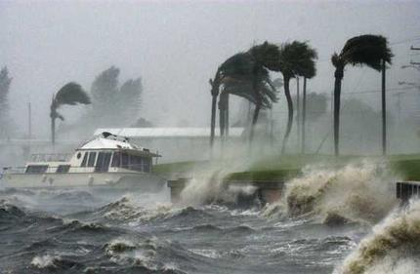

Hurricane Frances
Obvious vs non-obvious prediction
Notes:
What do you think the Walmart’s Chief Information Officer did?
She asked her staff to predict the outcome based on sales data after Hurricane Charley.
Obvious vs non-obvious prediction.
Why need data science/data mining?

Slide 14

Predicting Customer Churn
Think carefully about what data you might use and how they would be used. Specifically, how should MegaTelCo choose a set of customers to receive their offer in order to best
reduce churn for a particular incentive budget?

Slide 15
Case Study: Predicting Customer Churn
How are such data analyses performed? Consider a second, more typical business scenario and how it might be treated from a data perspective.
You just landed a great analytical job with MegaTelCo, one of the largest telecommunication firms in the United States. They are having a major problem with customer retention in their wireless business. In the mid-Atlantic region, 20% of cell phone customers leave when their contracts expire, and it is getting increasingly difficult to acquire new customers.
Since the cell phone market is now saturated, the huge growth in the wireless market has tapered off. Communications companies are now engaged in battles to attract each other’s customers while retaining their own. Customers switching from one company to another is called churn, and it is expensive all around: one company must spend on incentives to attract a customer while another company loses revenue when the customer departs.
You have been called in to help understand the problem and to devise a solution. Attracting new customers is much more expensive than retaining existing ones, so a good deal of marketing budget is allocated to prevent churn. Marketing has already designed a special retention offer.
Your task is to devise a precise, step-by-step plan for how the data science team should use MegaTelCo’s vast data resources to decide which customers should be offered the special retention deal prior to the expiration of their contracts. Think carefully about what data you might use and how they would be used.

Slide 16
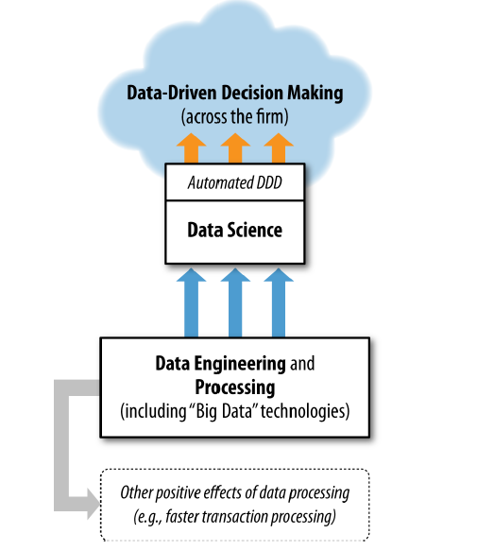
What is the different between Data Science and Data Engineering/Processing and Big Data?
Notes:
Data science needs access to data and it often benefits from sophisticated data engineering that data processing
technologies may facilitate, but these technologies are not data science technologies per
se. They support data science, as shown in Figure 1-1, but they are useful for much more.
Data processing technologies are very important for many data-oriented business tasks
that do not involve extracting knowledge or data-driven decision-making, such as efficient
transaction processing, modern web system processing, and online advertising
campaign management.
“Big data” technologies (such as Hadoop, HBase, and MongoDB) have received considerable
media attention recently. Big data essentially means datasets that are too large
for traditional data processing systems, and therefore require new processing technologies.
As with the traditional technologies, big data technologies are used for many
tasks, including data engineering. Occasionally, big data technologies are actually used
for implementing data mining techniques. However, much more often the well-known
big data technologies are used for data processing in support of the data mining techniques
and other data science activities, as represented in Figure 1-1.

Slide 17
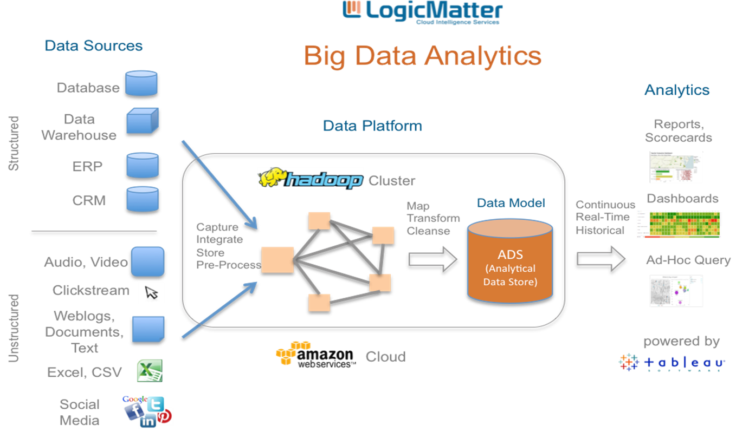

Slide 18


Target and Walmart interest in babies
“As soon as we get them buying diapers from us, they’re going to start buying everything else too.”
Since most birth records are public, retailers obtain information on births and send out special offers to the new parents.
They were interested in whether they could predict that people are expecting a baby.

Slide 19
Why we want to estimate?
If we can improve our ability to estimate, for a given customer, how profitable it would be for us to focus on her, we can potentially reap large benefits by applying this ability to the millions of customers in the population.
This same logic applies to many of the areas where we have seen the most intense application of data science and data mining: direct marketing, online advertising, credit scoring, financial trading, help-desk management, fraud detection, search ranking, product recommendation, and so on.

Slide 20
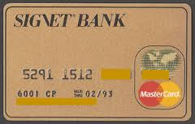

Investing in Data Assets
The best data science team can yield little value without the appropriate data
Previously, credit cards essentially had uniform pricing.
No dataset on model profitability with the goal of offering different terms to different customers.
In Signet’s case, data could be generated on the profitability of customers given different credit terms by conducting experiments.
pricing, credit limits, low-initial-rate balance
transfers, cash back, loyalty points

Slide 21
Activities (15 minutes)
Is your company structured towards data-driven business? If not, is there any initiatives going toward it?
What process and technologies that supports the strategy?
Give one example how can data-driven business may help your company.
*Summarize it and tell it to the class.

Slide 22
Some Fundamentals Concepts
Extracting useful knowledge from data to solve business problems can be treated systematically by following a process with reasonably well-defined stages.
If you look too hard at a set of data, you will find something—but it might not generalize beyond the data you’re looking at.
From a large mass of data, information technology can be used to find informative descriptive attributes of entities of interest.
Formulating data mining solutions and evaluating the results involves thinking carefully about the context in which they will be used.
The Data Mining Process (CRISP-DM)
Using the right dataset/attributes
Overfitting!
Creating values from the discovered patterns.

Slide 23
Decomposing business problems into subtasks
For example, the telecommunications churn problem is unique to MegaTelCo: there are specifics of the problem that are different from churn problems of any other telecommunications firm.
However, a subtask that will likely be part of the solution to any churn problem is to estimate from historical data the probability of a customer terminating her contract shortly after it has expired.
Once the MegaTelCo data have been assembled into a particular format , this probability estimation fits the mold of one very common data mining task.

Slide 24

Have you the got the right question?

Slide 25
Group Discussion/Knowledge Sharing
What is the business problem?
What is the right question to ask?
What are the data needed?
What are the issues may arise?
*In a group with the topic that you have selected.

Slide 26

Data Mining Principles

Slide 27
Definitions of Data Mining
Data mining is sorting through data to identify patterns and establish relationships
TechTarget.com
Data mining is the use of efficient techniques for the analysis of very large collections of data and the extraction of useful and possibly unexpected patterns in data.
Data mining is the computational process of discovering patterns in large data sets involving methods at the intersection of artificial intelligence, machine learning, statistics, and database systems.
KDD.org

Slide 28
Data Mining Tasks
Classification and class probability estimation
“Among all the customers of MegaTelCo, which are likely to respond to a given offer?” In this example the two classes could be called will respond and will not respond.
Regression
“How much will a given customer use the service?”
Similarity matching
To identify similar individuals based on data known about them.
Clustering
“Do our customers form natural groups or segments?”

Slide 29
Data Mining Tasks
Co-occurrence grouping
Profiling (or behaviour description)
“What is the typical cell phone usage of this customer segment?”
Link prediction
“Since you and Karen share 10 friends, maybe you’d like to be Karen’s friend?”
Data reduction
Which of these tasks are suitable for your problem?

Slide 30
Supervised vs Unsupervised Methods
“Do our customers naturally fall into different groups?”
“Can we find groups of customers who have particularly high likelihoods of canceling their service soon after their contracts expire?” Here there is a specific target defined: will a customer leave when her contract expires? In this case, segmentation is being done for a specific reason: to take action based on likelihood of churn. This is called a supervised data mining problem.

Slide 31
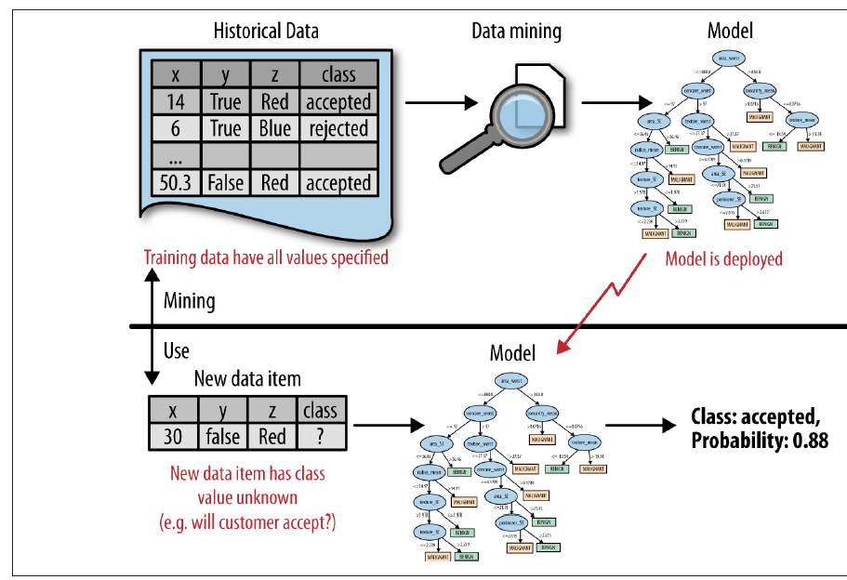
Data mining versus the use of data mining results

Slide 32
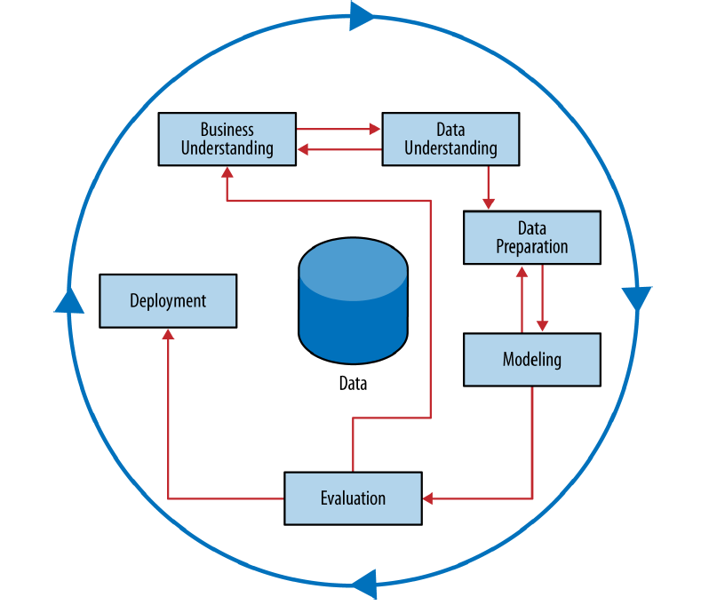
The CRISP data mining process
https://en.wikipedia.org/wiki/Cross_Industry_Standard_Process_for_Data_Mining
Fundamental concept 1: Extracting useful knowledge from data to solve business problems can be treated systematically by following a process with reasonably well-defined stages.

Slide 33
Business Understanding
The Business Understanding stage represents a part of the craft where the analysts’ creativity plays a large role.
The design team should think carefully about the use scenario.
What exactly do we want to do? How exactly would we do it? What parts of this use scenario constitute possible data mining models?

Slide 34
Your Group Task
What are the decisions needed to be done?
What data is needed to achieve the objectives?
What are the issues involved? E.g. money, not enough data, privacy etc.
Supervised and unsupervised questions?
Decomposing business problems into subtasks.

Slide 35
Data Understanding
Historical data. Are they 100% useful?
Different databases may have varying degrees of reliability: e.g. customer database, transaction, marketing response
How about the costs of data?
Labelled and unlabelled target variable.

Slide 36
Labelled and unlabelled target variable
Catching credit card fraud
Catching Medicare fraud.
?
?
Charges show up on each customer’s account, so fraudulent charges are usually caught—if not initially by the company, then later by the customer when account activity is reviewed. We can assume that nearly all fraud is identified and reliably labeled, since the legitimate customer and the person perpetrating the fraud are different people and have opposite goals. Thus credit card transactions have reliable labels (fraud and legitimate) that may serve as targets for a supervised technique.
The perpetrators of fraud—medical providers who submit false claims, and sometimes their patients— are also legitimate service providers and users of the billing system. Those who commit fraud are a subset of the legitimate users; there is no separate disinterested party who will declare exactly what the “correct” charges should be. Consequently the Medicare billing data have no reliable target variable indicating fraud, and a supervised learning approach that could work for credit card fraud is not applicable. Such a problem usually requires unsupervised approaches such as profiling, clustering, anomaly detection, and co-occurrence grouping.
Unlabeled variable
Labelled variable
Notes:
Charges show up on each customer’s account, so fraudulent charges are usually caught—if not initially by the company, then later by the customer when account activity is reviewed. We can assume that nearly all fraud is identified and reliably labeled, since the legitimate customer and the person perpetrating the fraud are different people and have opposite goals. Thus credit card transactions have reliable labels (fraud and legitimate) that may serve as targets for a supervised technique.
The perpetrators of fraud—medical providers who submit false claims, and sometimes their patients— are also legitimate service providers and users of the billing system. Those who commit fraud are a subset of the legitimate users; there is no separate disinterested party who will declare exactly what the “correct” charges should be. Consequently the Medicare billing data have no reliable target variable indicating fraud, and a supervised learning approach that could work for credit card fraud is not applicable. Such a problem usually requires unsupervised approaches such as profiling, clustering, anomaly detection, and co-occurrence grouping.

Slide 37
Your Group Tasks
What data are needed?
Supervised or unsupervised (labelled or unlabelled problems?)
Do you need to invest on the data?

Slide 38
Data Preparation
Some tasks:
Converting data to tabular format
Remove missing values
Convert to different types
Normalized or scaled the data

Slide 39
Modelling
The modeling stage is the primary place where data mining techniques are applied to the data. Examples:
Statistical Modelling
Decision Tree
Instance-based Learning
Support Vector Machines
Neural Networks
Clustering

Slide 40
Evaluation
At this stage in the project you have built a model (or models) that appears to have high quality, from a data analysis perspective.
Before proceeding to final deployment of the model, it is important to more thoroughly evaluate the model, and review the steps executed to construct the model, to be certain it properly achieves the business objectives.

Slide 41
Deploying
Put into real use in order to realize some return on investment.
Implementing a predictive model in some information system or business process.
Targeting online advertisement
Example on the customer churn: sending special offers to customers who are predicted to be particularly at risk.

Slide 42
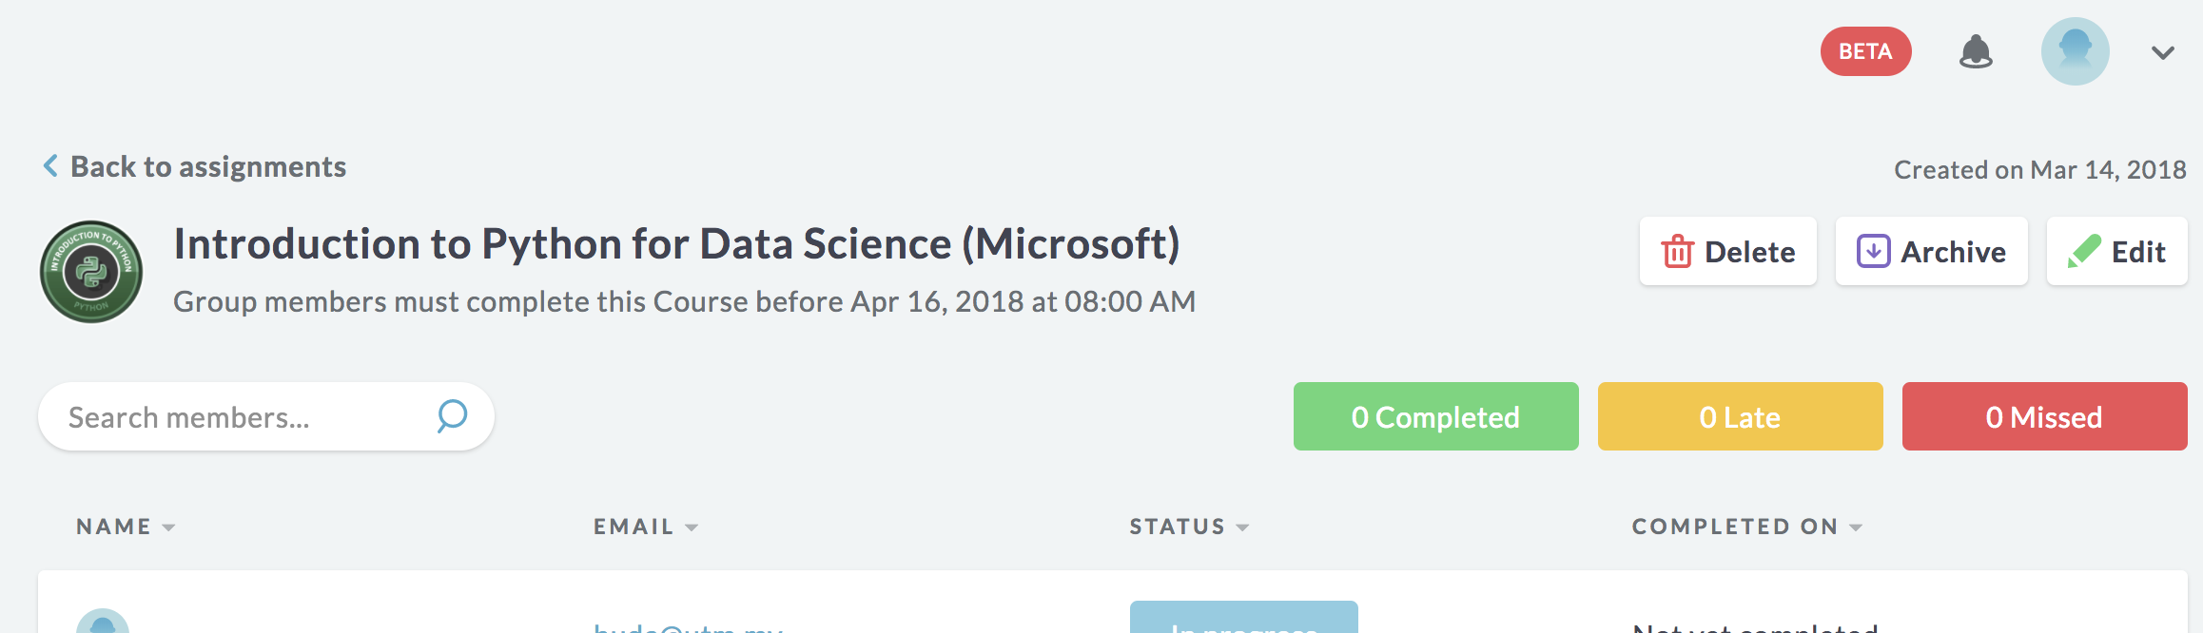
This week assignment
Complete the Data Camp: Introduction to Python for Data Science
https://www.datacamp.com/enterprise/manb1153-kohort03/assignments/21300

Slide 43
Data Mining: Data and Data Preparation

